Slide 1
Predicting the Success of Bone Marrow Transplant and Classifying Acute Lymphoblastic Leukemia
By: Duc Anh Dang, Ruiting Chen, Chris Zhou, Anurag Jakkula
Notes:
Duc

Slide 2
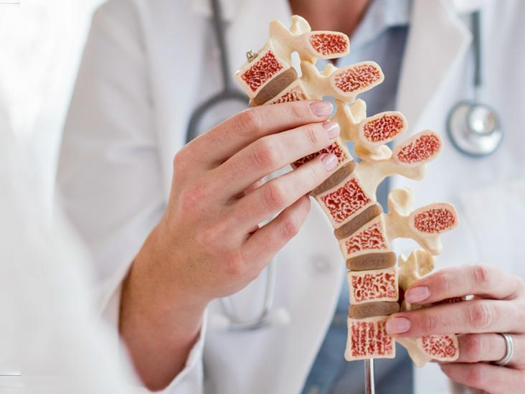
Our inspiration
The importances of the bone marrow:
Make the components of your blood
Carry oxygen
Prevent bleeding
Bone marrow can be damaged by:
Drugs
Radiation
Cancer
=> 6,660 cases of Acute Lymphoblastic Leukemia per year in the U.S. (American Cancer Society)
=> Therefore, it is necessary to evaluate the efficacy of bone marrow transplants through the survival of those patients as well as early detection of the cancer to allow for timely bone marrow treatment.
Notes:
Bone marrow makes the components of your blood that you need to survive. Bone marrow produces red blood cells that carry oxygen, white blood cells that prevent infection and platelets that control bleeding. The absence of bone marrow can be fatal since it's an essential part of your body. When the doses of chemotherapy or radiation needed to cure a cancer are so high that a person's bone marrow stem cells will be permanently damaged or destroyed by the treatment, a bone marrow transplant may be needed. The goal of a bone marrow transplant is to cure many diseases and types of cancer.
Chris

Slide 3
We use a dataset from Faculty of Automatic Control, Electronics and Computer Science, Silesian University of Technology, 44-100 Gliwice, Poland to predict the survival of bone marrow transplant.
https://archive.ics.uci.edu/ml/datasets/Bone+marrow+transplant%3A+children
Next, we use a dataset of images from Munich Leukemia Laboratory (MLL) to classify bone marrow cell types and healths.
https://www.kaggle.com/datasets/andrewmvd/bone-marrow-cell-classification
Notes:
We decided to choose the bone marrow transplant dataset from uci machine learning websites that describes pediatric patients with several hematologic diseases, who were subject to the unmanipulated allogeneic unrelated donor hematopoietic stem cell transplantation.
Chris

Slide 4
Bone Marrow Transplant Survival Classification
Notes:
Duc

Slide 5
Table of Contents
Data description and preprocessing
Results
Methods used
Conclusions
Notes:
Duc

Slide 6
Project Background
Bone marrow transplants relate to treatment of cancer and other deadly diseases
Potential rejection of new cells from transplant can do more harm
The process is also very lengthy and complicated, adding risk
Utilizing different features of the recipient and donor, we aim to predict whether a bone marrow transplant will be successful in helping a recipient recover from radiation or chemotherapy.
Correlation can be helpful for deciding who is the best donor for specific recipients.
Notes:
Duc

Slide 7
Features-39
donor_age - Age of the donor
donor_age_below_35 - Is donor age less than 35 (yes, no)
donor_ABO - ABO blood group of the donor of hematopoietic stem cells (0, A, B, AB)
recipient_age - Age of the recipient of hematopoietic stem cells at the time of transplantation
recipient_age_below_10 - Is recipient age below 10 (yes, no)
recipient_gender - Gender of the recipient (female, male)
recipient_body_mass - Body mass of the recipient of hematopoietic stem cells at the time of the transplantation
risk_group - Risk group (high, low)
survival_time - Time of observation (if alive) or time to event (if dead) in days
relapse - Relapse of the disease (yes, no)
Notes:
Duc 39

Slide 8
Features Cont’d
stem_cell_source - Source of hematopoietic stem cells (peripheral blood, bone marrow)
tx_post_relapse - The second bone marrow transplantation after relapse (yes ,no)
CD34_x1e6_per_kg - CD34kgx10d6 - CD34+ cell dose per kg of recipient body weight (10^6/kg)
CD3_x1e8_per_kg - CD3+ cell dose per kg of recipient body weight (10^8/kg)
CD3_to_CD34_ratio - CD3+ cell to CD34+ cell ratio
ANC_recovery - Neutrophils recovery defined as neutrophils count >0.5 x 10^9/L (yes, no)
time_to_ANC_recovery - Time in days to neutrophils recovery
PLT_recovery - Platelet recovery defined as platelet count >50000/mm3 (yes, no)
time_to_PLT_recovery - Time in days to platelet recovery
acute_GvHD_II_III_IV - Development of acute graft versus host disease stage II or III or IV (yes, no)
acute_GvHD_III_IV - Development of acute graft versus host disease stage III or IV (yes, no)..
Notes:
Duc

Slide 9
Our Target
survival_status:
Survival status (0 - alive, 1 - dead)
Notes:
Duc

Slide 10
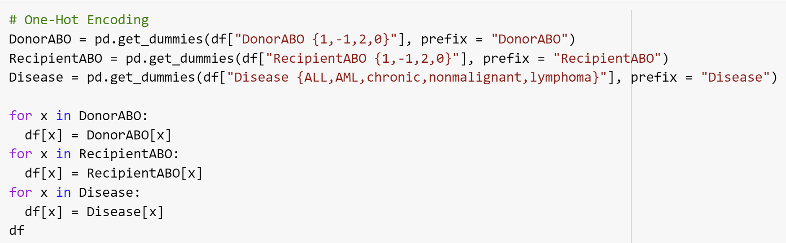
One-Hot Encoding
Notes:
Duc

Slide 11
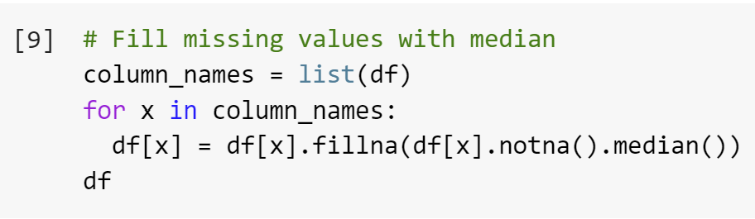
Dealing with Missing Data
Notes:
Duc

Slide 12
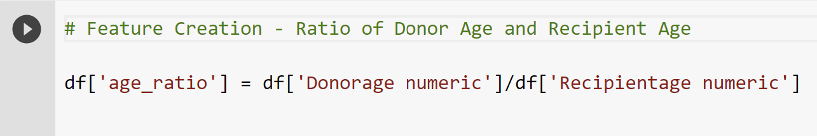
Feature Creation
Notes:
Duc

Slide 13
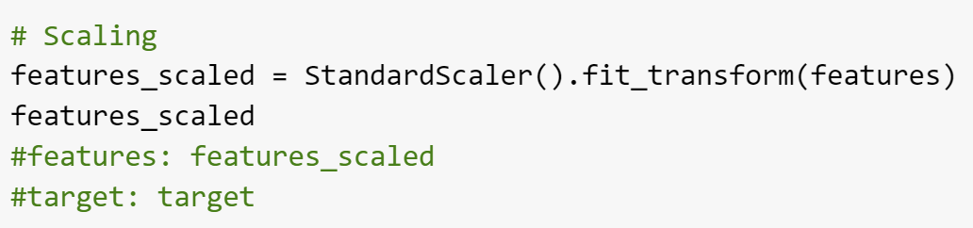
Z-Scale Normalization
Notes:
Duc

Slide 14
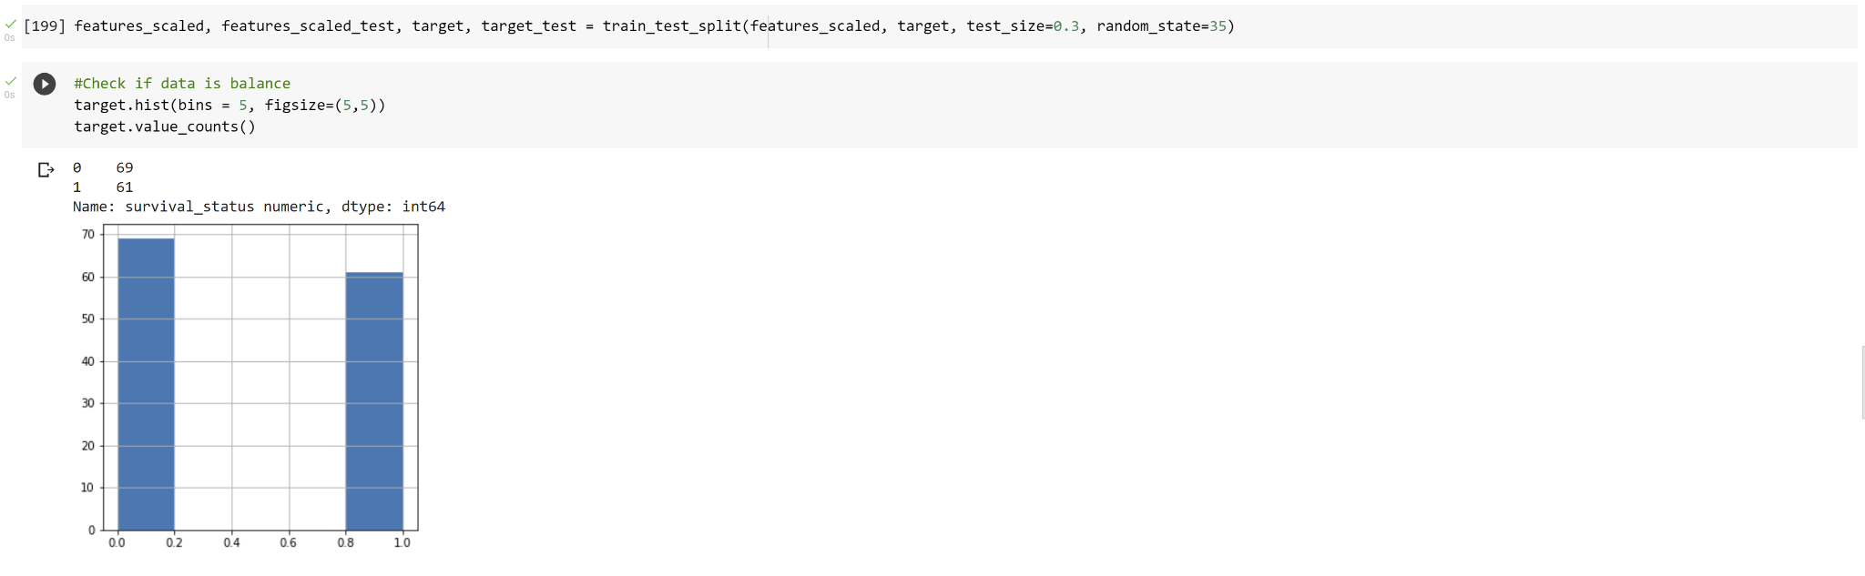
Balance of Data
Notes:
Duc

Slide 15
Methods
Support Vectors Machine
Logistic regressions
Decision Tree
Using different kernels and lambdas
With and without regularization
Gini vs Entropy
Notes:
We use 3 different methods to find the best fit to the model: Logistic regressions, Support vector machine and decision tree. For logistic regressions, we try it with and without regularization. For SVM, we test with kernel: linear, poly, sigmoid and different lambdas to find the optimal line. For decision tree, first, we compare between gini and entropy, then we find the ideal mean samples leaf and mean impurity decrease for the datasets
Duc

Slide 16
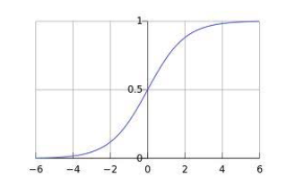
Logistic Regression
Notes:
Anurag

Slide 17
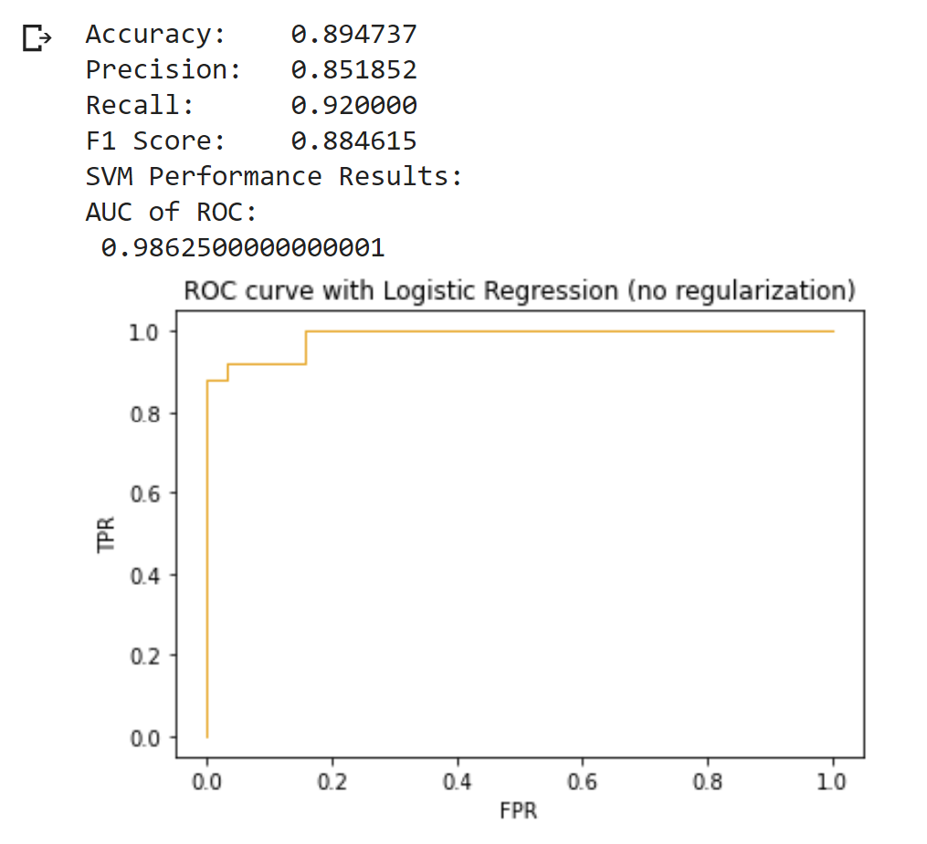
Logistic Regression (no regularization)
Notes:
Anurag

Slide 18
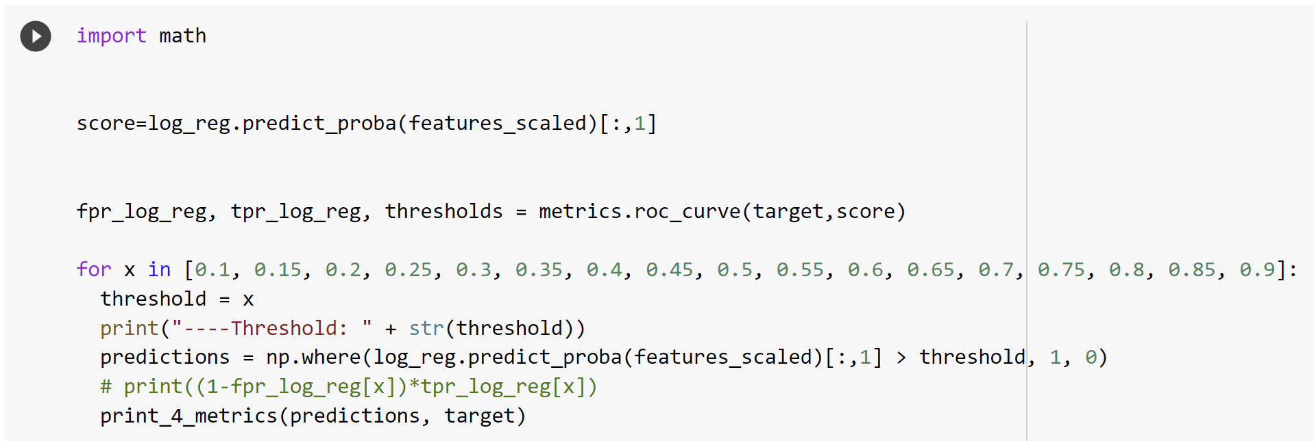
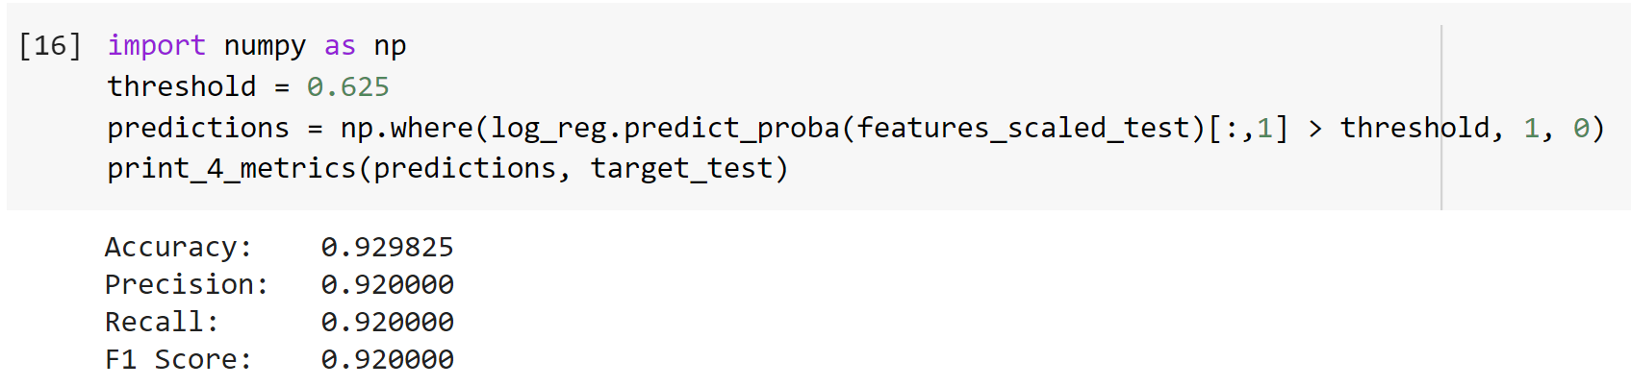
Decision Threshold Modification
Notes:
Anurag

Slide 19
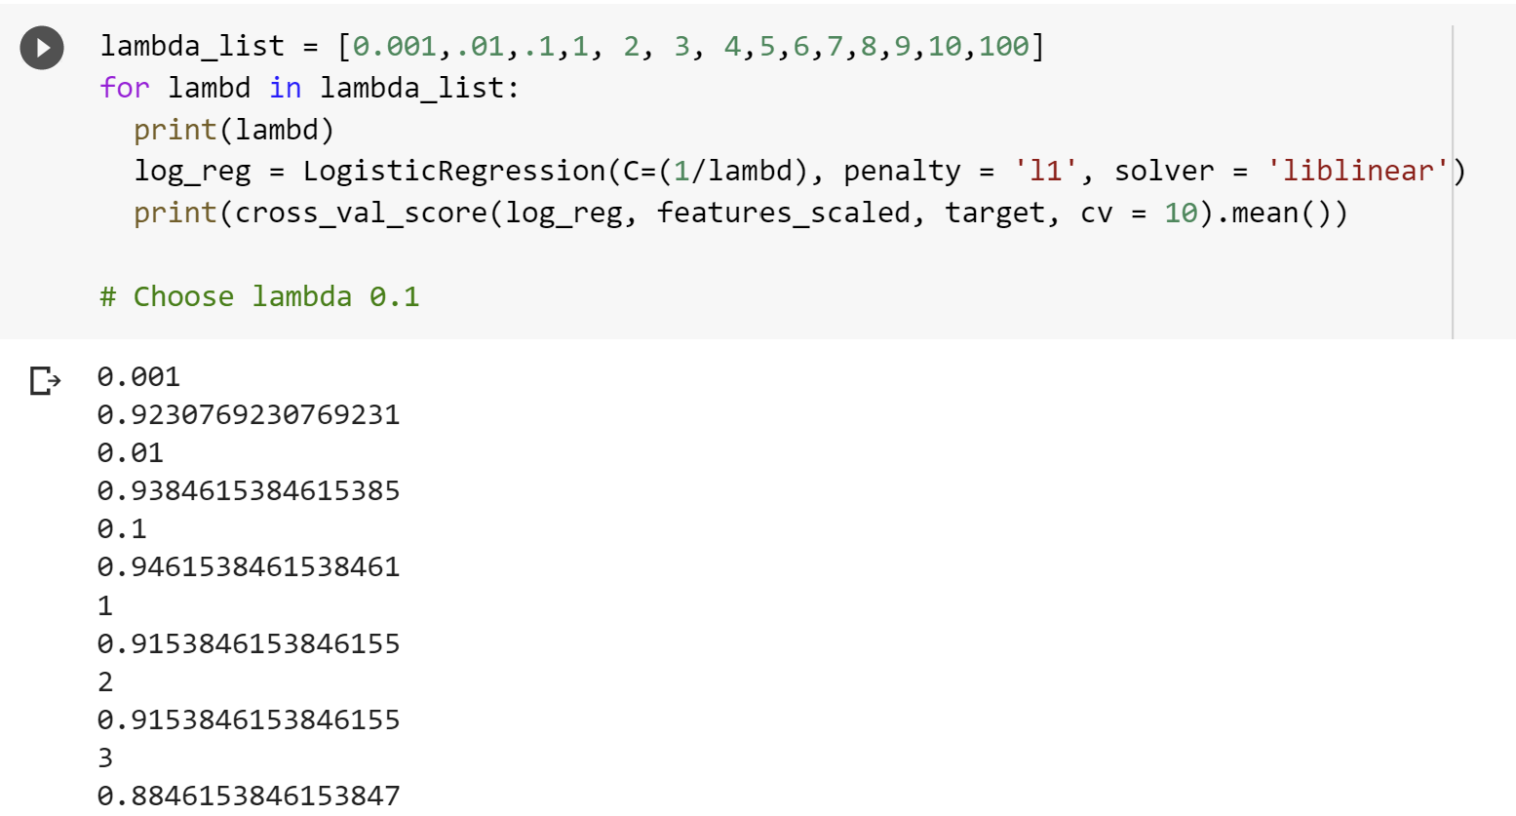
Logistic Regression (L1 Lambda Selection)
Notes:
Anurag

Slide 20
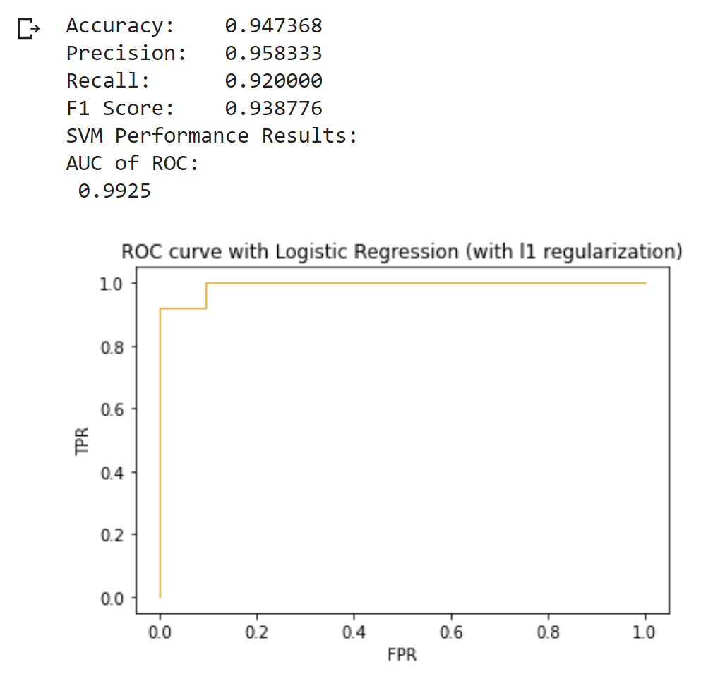
Results
Notes:
Anurag

Slide 21
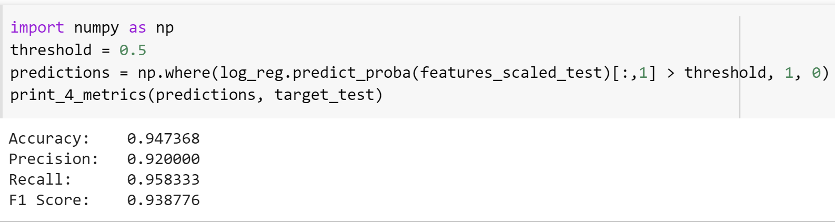
Threshold Selection
Notes:
Anurag

Slide 22
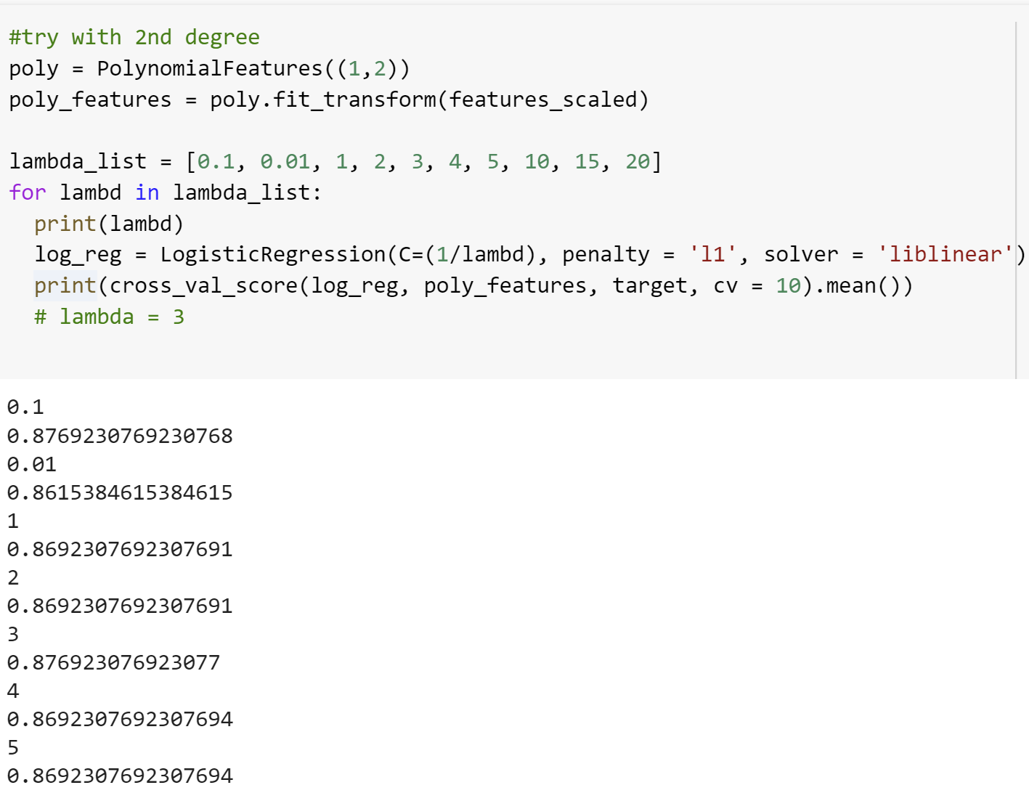
Polynomial Logistic Regression Lambda Selection
Notes:
Anurag

Slide 23
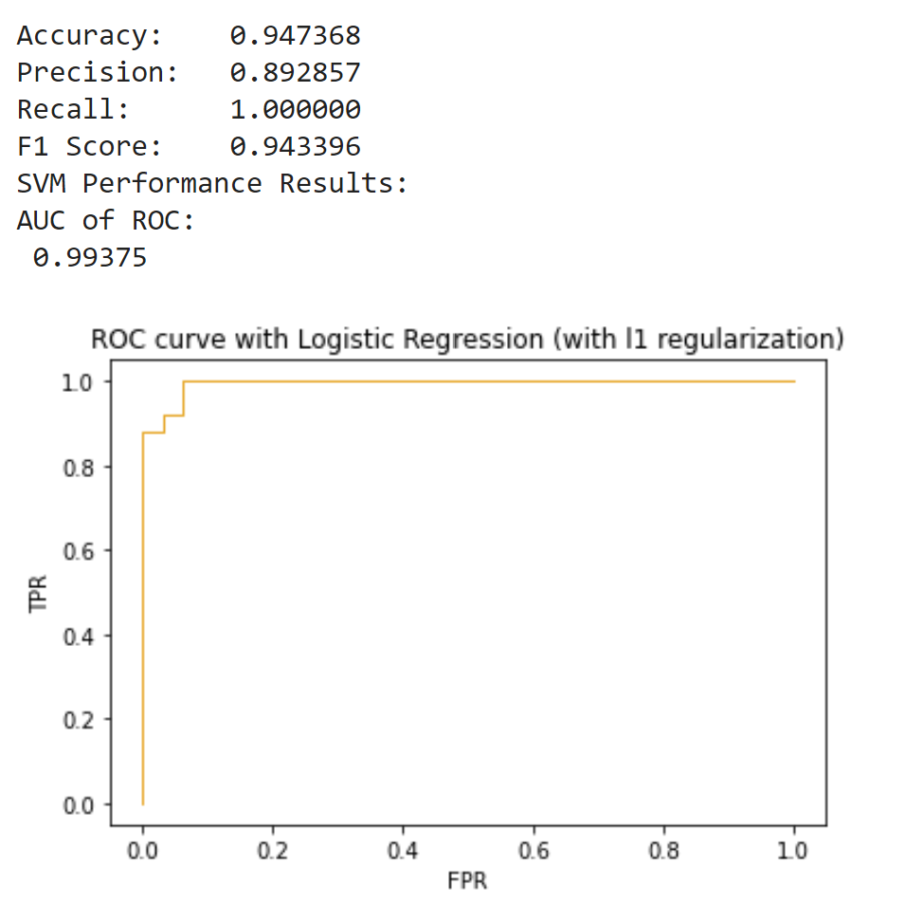
Results
Notes:
Anurag

Slide 24
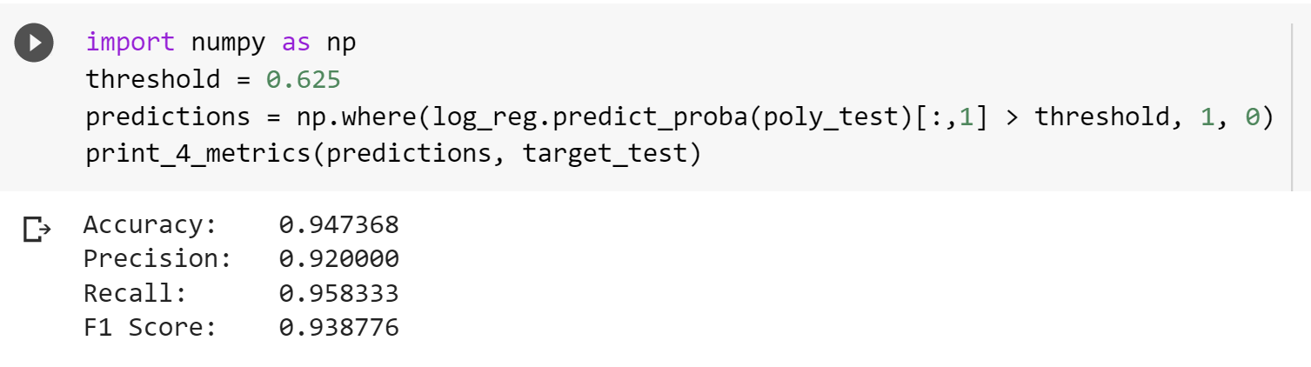
Threshold Selection
Notes:
Anurag

Slide 25
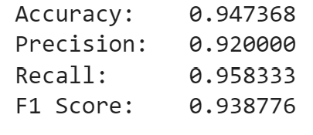
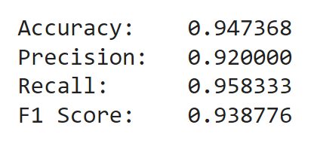
Compare Results
Without regularization
Polynomial features with l1 regularization
Linear features with l1 regularization
Notes:
Anurag

Slide 26
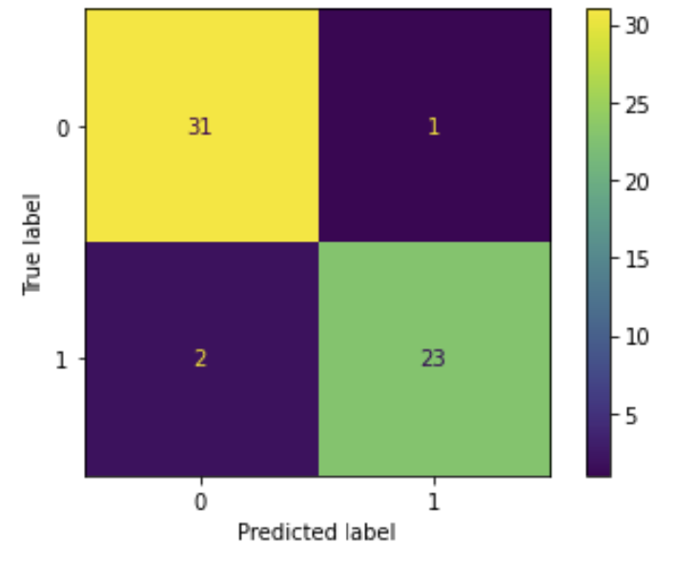
Final Results
Notes:
Anurag

Slide 27
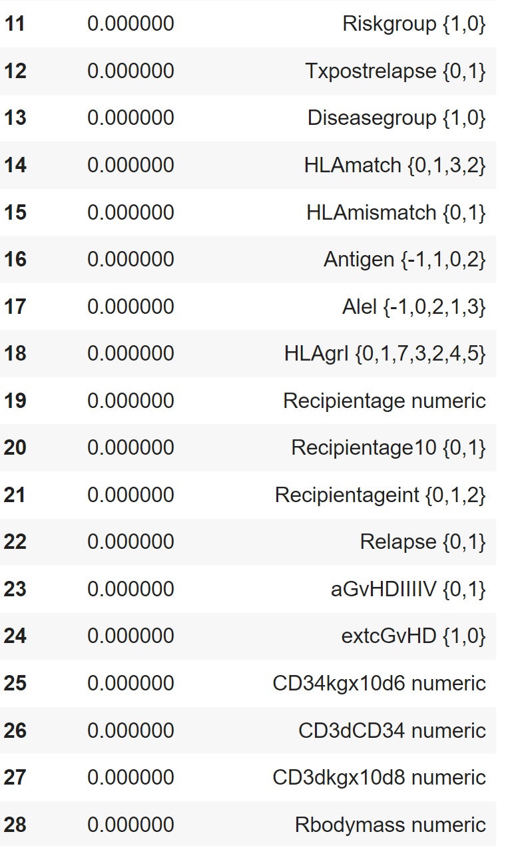
Features Removed
Notes:
Anurag

Slide 28
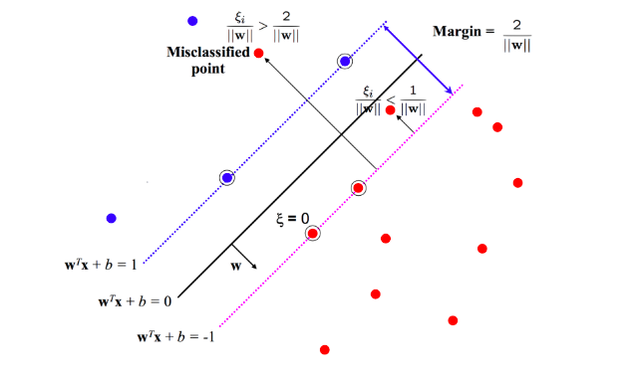
Support Vector Machine
Notes:
Raymond

Slide 29
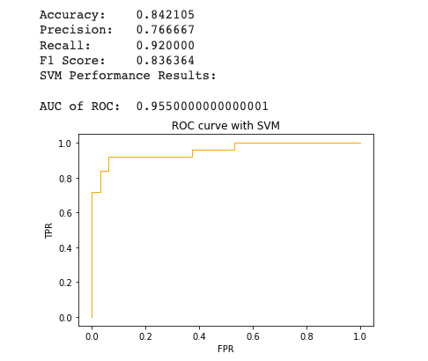
Support Vector Machine Default
Notes:
Raymond

Slide 30
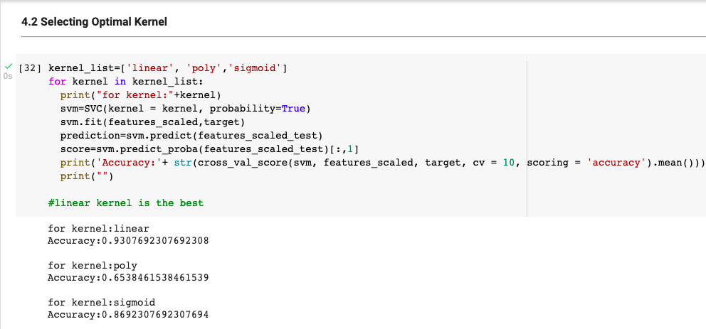
SVM (Kernel Selection)
Notes:
Raymond

Slide 31
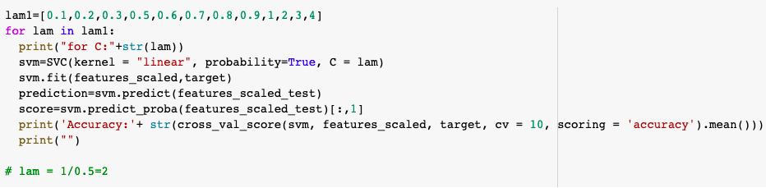
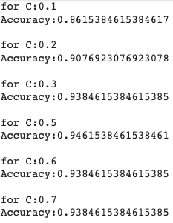
SVM (λ Selection)
Notes:
Raymond

Slide 32
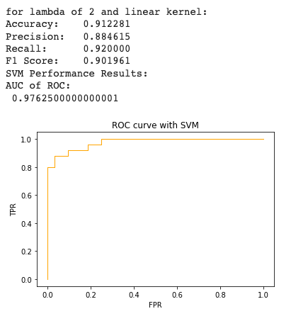
Final Performance
Notes:
Raymond

Slide 33
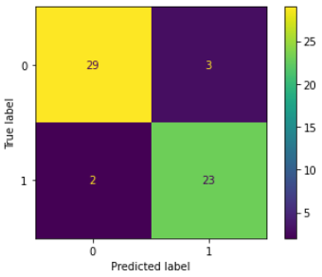
Final Results
Notes:
Raymond

Slide 34
Decision Tree
Notes:
Chris

Slide 35
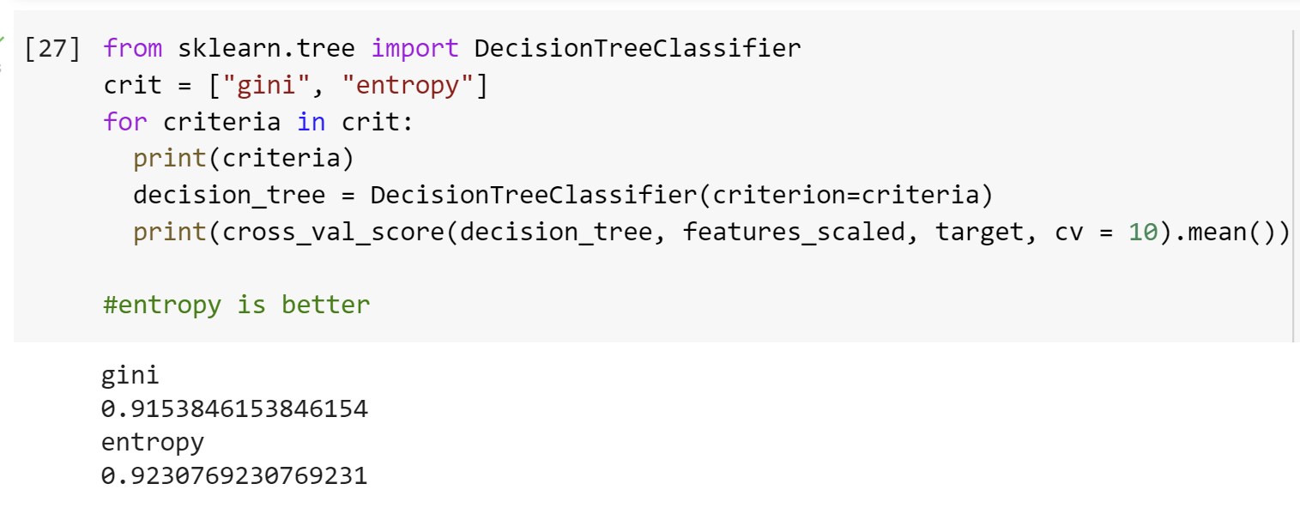
Decision tree (entropy vs gini)
Notes:
Chris

Slide 36
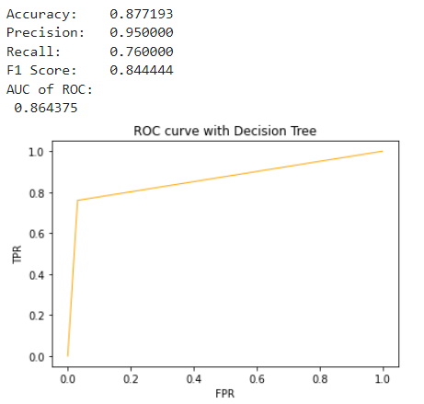
Results

Slide 37
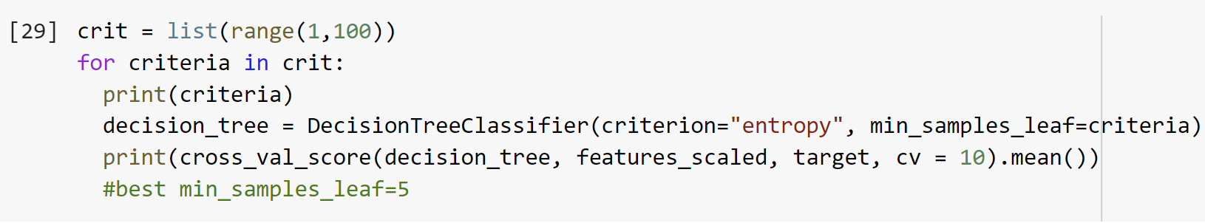
Decision tree (min samples leaf)
Notes:
Chris

Slide 38
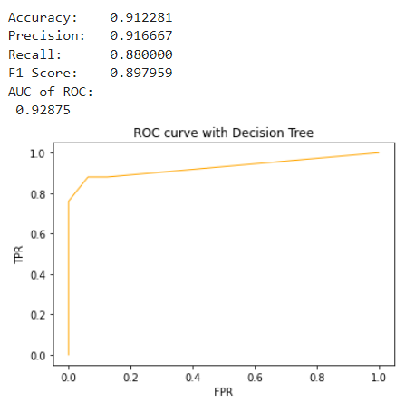
Results

Slide 39
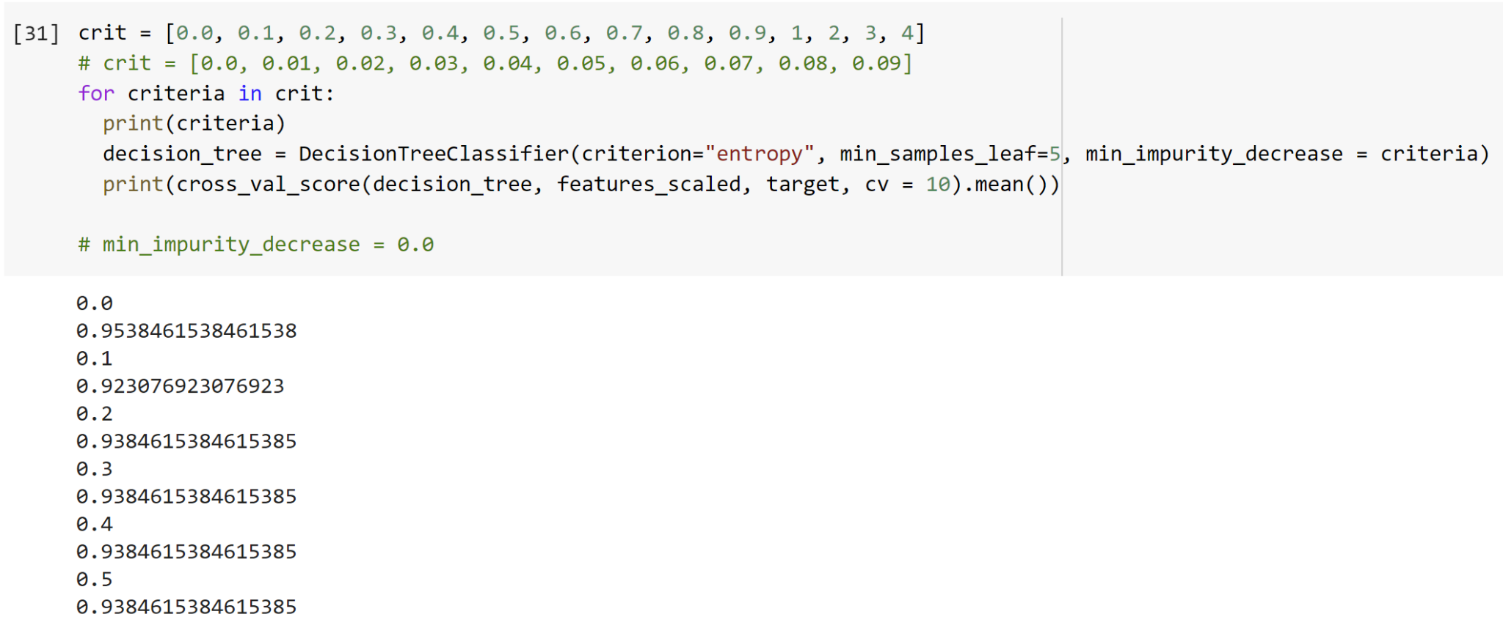
Decision tree (min impurity decrease)
Notes:
Chris

Slide 40
Final Results
Notes:
Chris

Slide 41
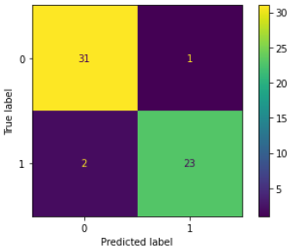
Final Results
Notes:
Chris

Slide 42
Best Model: Logistic Regression w/ L1 Regularization

Slide 43
Bone Marrow Cell Classification

Slide 44
The Problem
Acute Lymphoblastic Leukemia
Cancer that occurs in bone marrow
Classifying cells in bone marrow according to benign, early pre-B, pre-B, and pro-B ALL can be highly beneficial in detecting cancer early to maximize the efficacy of treatments such as bone marrow transplants
Early pre-B, pre-B, and pro-B ALL are malignant cells associated with the stage of cancer
Notes:
Raymond

Slide 45
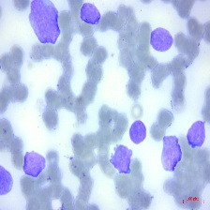
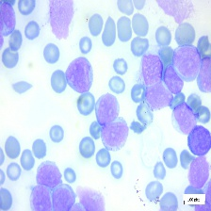
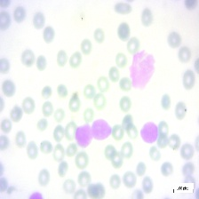
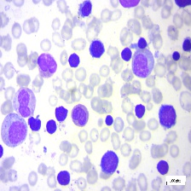
Images
Early Pre-B | Pre-B
Pro-B ALL | Benign
Notes:
Chris

Slide 46
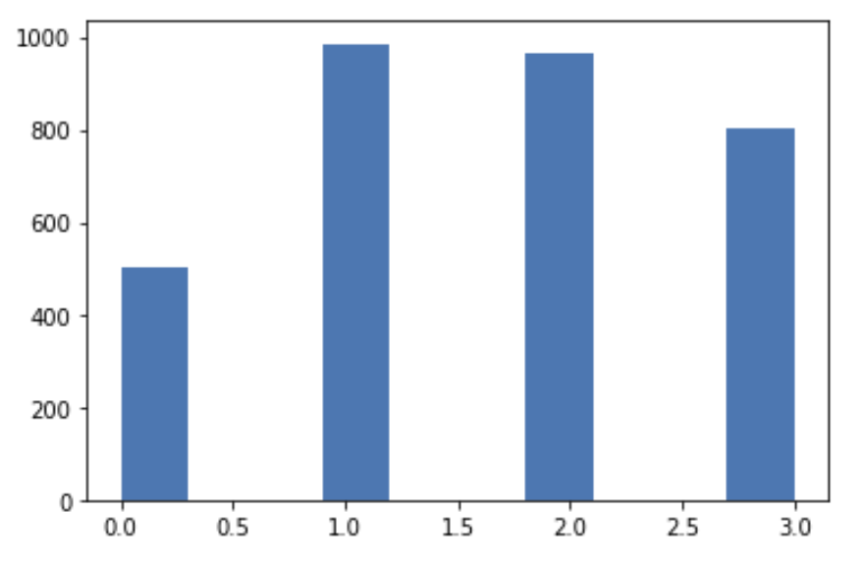
Data Preparation
Oversampling
One-hot encoding target

Slide 47
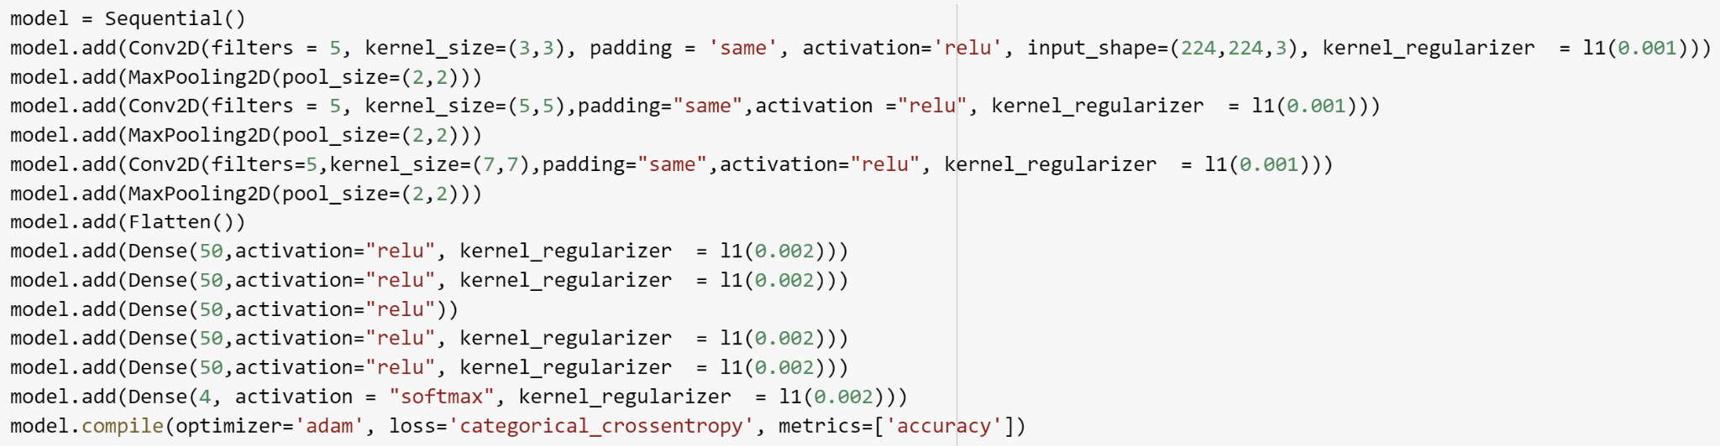
CNN Model
Notes:
Anurag

Slide 48
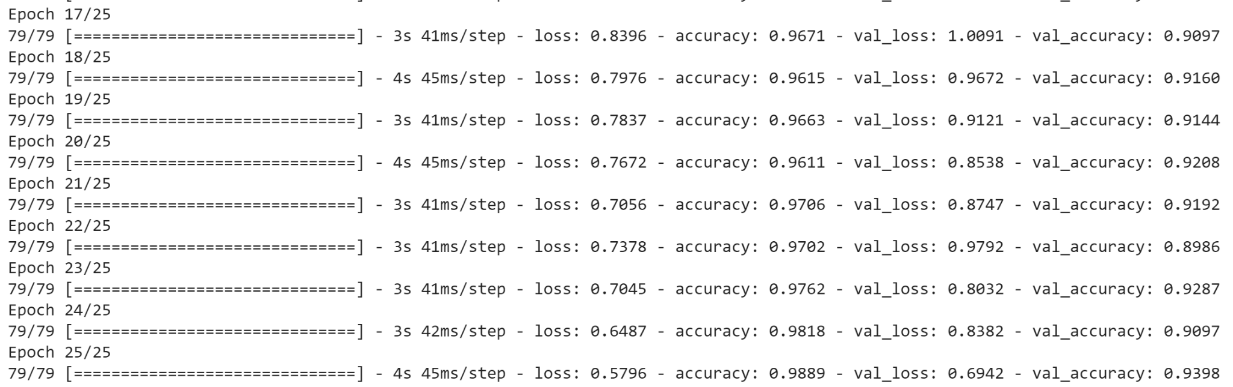
Validation

Slide 49
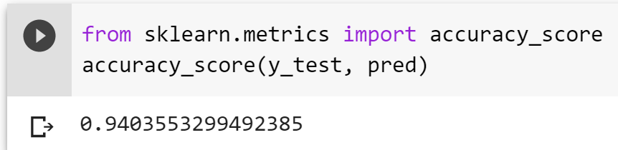
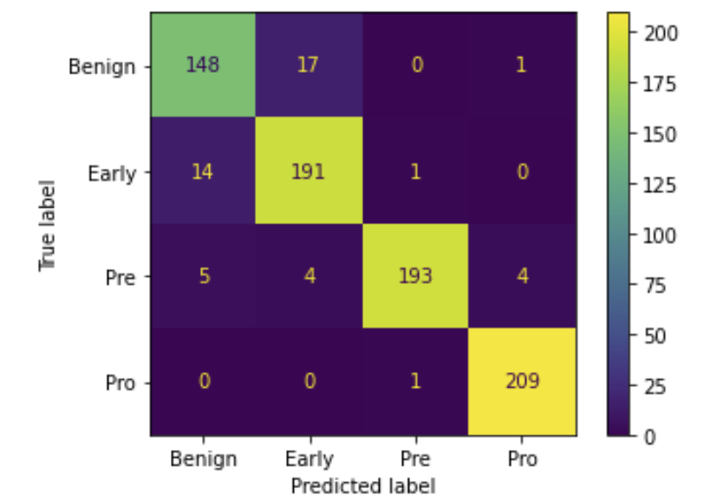
Results
Notes:
Chris

Slide 50
Observations
For this particular dataset, smaller filters worked much better
Big filters placed on top of smaller filters were able to capture the patterns of smaller image features
A small amount of regularization on convolutional layers played a huge role in avoiding overfitting
A more complex model is not necessarily better; it takes much longer to converge
Notes:
Duc

Slide 51
References
Sikora, Marek, et al. “Bone Marrow Transplant: Children Data Set.” UCI Machine Learning Repository: Bone Marrow Transplant: Children Data Set, https://archive.ics.uci.edu/ml/datasets/Bone+marrow+transplant%3A+children.
Larxel. “Bone Marrow Cell Classification.” Kaggle, 23 Jan. 2022, https://www.kaggle.com/datasets/andrewmvd/bone-marrow-cell-classification.

